Slide 1
Illumination Model
‹#›

Slide 2
An illumination model, also called a lighting model and sometimes referred to as a shading model, is used to calculate the intensity of light that we should see at a given point on the surface of an object.
Surface rendering means a procedure for applying a lighting model to obtain pixel intensities for all the projected surface positions in a scene.
‹#›

Slide 3
A surface-rendering algorithm uses the intensity calculations from an illumination model to determine the light intensity for all projected pixel positions for the various surfaces in a scene.
Surface rendering can be performed by applying the illumination model to every visible surface point
‹#›

Slide 4
LIGHT SOURCES
light sources are referred to as light-emitting
sources; and reflecting surfaces, such as the walls of a room, are termed light-reflecting sources
A luminous object, in general, can be both a light source and a light reflector.
The simplest model for a light emitter is a point source.
‹#›

Slide 5
When light is incident on an opaque surface, part of it is reflected and part is absorbed.
The amount of incident light reflected by a surface depends on the type of material. Shiny materials reflect more of the incident light, and dull surfaces absorb more of the incident light.
for an illuminated transparent surface, some of the incident light will be reflected and some will be transmitted through the material
‹#›

Slide 6
Surfaces that are rough, or grainy, tend to scatter the reflected light in all directions.
This scattered light is called diffuse reflection.
In addition to diffuse reflection, light sources create highlights, or bright spots, called specular reflection.
This highlighting effect is more pronounced on shiny surfaces than on dull surfaces
‹#›

Slide 7
Ambient Light
In our basic illumination model, we can set a general level of brightness for a scene. This is a simple way to model the combination of light reflections from various surfaces to produce a uniform illumination called the ambient light, or background light.
Ambient light has no spatial or directional
characteristics. The amount of ambient light incident on each object is a constant for all surfaces and over all directions.
‹#›

Slide 8
Diffuse Reflection
Diffuse reflections are constant over each surface in a scene
The fractional amount of the incident light that is diffusely reflected can be set for each surface with parameter k_{d}, the diffuse-reflection coefficient, or diffuse reflectivity.
‹#›

Slide 9
Parameter k_{d} is assigned a constant value in the interval 0 to 1.
we want a highly reflective surface, we set the value of k_{d} near 1. This produces a bright surface with the intensity of the reflected light near that of the incident light.
To simulate a surface that absorbs most of the incident light, we set the reflectivity to a value near 0.
‹#›

Slide 10
If a surface is exposed only to ambient light, we can express the intensity of the diffuse reflection at any point on the surface as
I _{amb diff} = k _{d} I _{a}
‹#›

Slide 11
we assume that the diffuse reflections from the surface are scattered with equal intensity in all directions, independent of the viewing directions.
Such surfaces are sometimes referred to as ideal diffuse reflectors. They are also called Lambertian reflectors, since radiated light energy from any point on the surface is governed by Lambert’s cosine law.
‹#›

Slide 12
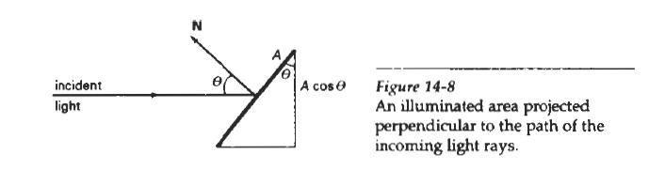
If we denote the angle of incidence between the incoming light direction and the surface normal as ϴ, then the projected area of a
surface patch perpendicular to the light direction is proportional to cos ϴ .
‹#›

Slide 13
Thus, the amount of illumination (or the "number of incident light rays" cutting across
the projected surface patch) depends on cos ϴ.
If the incoming light from the source is perpendicular to the surface at a particular point, that point is fully illuminated.
As the angle of illumination moves away from the surface normal, the brightness of the point drops off.
‹#›

Slide 14
If I_{l} , is the intensity of the point light source, then the diffuse reflection equation for a point on the surface can be written as
I _{l} _{,diff} = k _{d} I _{l} cos ϴ
A surface is illuminated by a point source only if the angle of incidence is in the range 0° to 90 ° (cos 0 is in the interval from 0 to 1).
When cos ϴ is negative, the light source is "behind" the surface.
‹#›

Slide 15
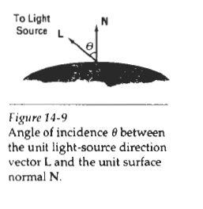
‹#›

Slide 16
If N is the unit normal vector to a surface and L is the unit direction vector to the point light source from a position on the surface, then
cos ϴ = N . L
and the diffuse reflection equation for single point-source illumination is
I _{l} _{,diff} = k _{d} I _{l} N. L
‹#›

Slide 17
We can combine the ambient and point source intensity calculations to obtain an expression for the total diffuse reflection.
In addition, many graphics packages introduce an ambient-reflection coefficient k_{a} to modify the ambient light intensity I, for each surface. This simply provides us with an additional parameter to adjust the light conditions in a scene.
‹#›

Slide 18
Using parameter k_{a} we can write the total diffuse reflection equation as
I _{l} _{,diff} = k _{a} I _{a} + k _{d} I _{l} ( N. L )
where both k _{a} and k _{d} depend on surface material properties and are assigned values
in the range from 0 to 1
‹#›

Slide 19
Specular Reflection and the Phong Model
we see a highlight, or bright spot, at certain viewing directions. This phenomenon, called specular reflection, is the result of total, or near total reflection of the incident light in a concentrated region around the specular reflection angle.
The specular-reflection angle equals the angle of the incident light.
‹#›

Slide 20
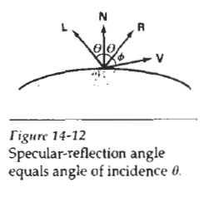
‹#›

Slide 21
In this figure, we use R to represent the unit vector in the direction of ideal specular reflection; L to represent the unit vector directed toward the point light source; and V as the unit vector pointing to the viewer from the surface position.
Angle ϴ is the viewing angle relative to the specular-reflection direction R.
For an ideal reflector (perfect mirror), incident light is reflected only in the specular-reflection direction. In this case, we would only see reflected light when vectors V and R coincide (ϴ = 0).
‹#›

Slide 22
Phong model, sets the intensity of specular reflection proportional to cos ^{n}_{s} ϴ.
Angle ϴ can be assigned values in the range 0 to 90, so that cos ϴ varies from 0 to 1.
The value assigned to specular-reflection parameter n_{s} is determined by the type of surface that we want to display.
A very shiny surface is modeled with a large value for n_{s} (say, 100 or more), and smaller values (down to 1) are used for duller surfaces.
For a perfect reflector, n_{s} is infinite.
‹#›

Slide 23

We can approximately model monochromatic
specular intensity variations using a specular-reflection coefficient, W(ϴ) for each surface.
In general, W(ϴ) tends to increase as the
angle of incidence increases.
Using the spectral-reflection function W(ϴ), we can write the Phong specular-reflection model as
‹#›

Slide 24
Since V and R are unit vectors in the viewing and specular-reflection directions,
we can calculate the value of cos ϴ with V . R
Assuming the specular-reflection coefficient is a constant, we can determine the intensity of
the specular reflection at a surface point with the calculation
I _{spec} = k_{s} I_{l} ( V. R ) ^{ns}
‹#›

Slide 25
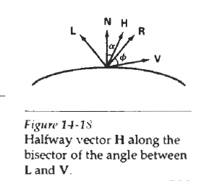
simplified Phong model is obtained by using the halfway vector H between L and V to calculate the range of specular reflections.
If we replace V.R in the Phong model with the dot product N . H, this simply replaces the empirical cos ϴ calculation with the empirical cos α calculation
‹#›

Slide 26
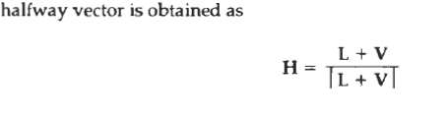
‹#›

Slide 27
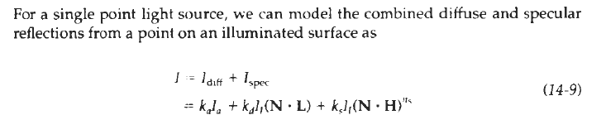
Combined Diffuse and Specular Reflections with Multiple Light Sources
‹#›

Slide 28

If we place more than one point source in a scene, we obtain the light reflection at any surface point by summing the contributions from the individual sources:
‹#›

Slide 29
Warn Model
The Warn model provides a method for simulating studio lighting effects by controlling light intensity in different directions.
Light sources are modeled as points on a reflecting surface, using the Phong model for the surface points.
Then the intensity in different directions is controlled by selecting values for the Phong exponent
‹#›

Slide 30
In addition, light controls and spotlighting, used by studio photographers can be simulated in the Warn model.
Flaps are used to control the amount of light emitted by a source In various directions
‹#›

Slide 31
Intensity Attenuation
As radiant energy from a point light source travels through space, its amplitude is attenuated by the factor l/d², where d is the distance that the light has travelled.
This means that a surface close to the light source (small d) receives a higher incident
intensity from the source than a distant surface (large d).
‹#›

Slide 32

A user can then fiddle with the coefficients a_{o}, a₁, and a₂ , to obtain a variety of lighting effects for a scene. The value of the constant term a_{o} can be adjusted to prevent f(d) from becoming too large when d is very small.
a general inverse quadratic attenuation function can be set up as
‹#›

Slide 33
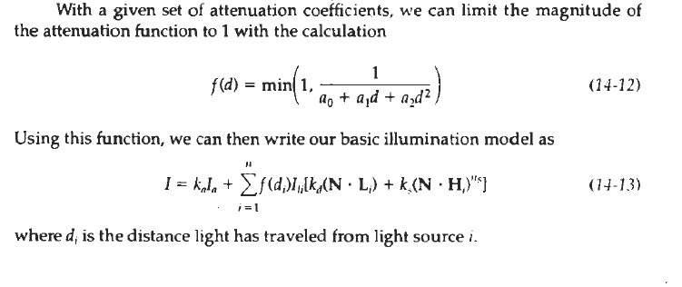
‹#›

Slide 34
Colour Considerations
Most graphics displays of realistic scenes are in colour. But the illumination model discussed so far considers only monochromatic lighting effects.
To incorporate colour, we need to write the intensity equation as a function of the colour
properties of the light sources and object surfaces.
‹#›

Slide 35
One way to set surface colors is by specifing
the reflectivity coefficients as three-element vectors.
The diffuse reflection coefficient vector, for example, would then have RGB components
( k_{dR} , k_{dG} , k_{dB} )
If we want an object to have a blue surface, we select a nonzero value in the range from 0 to 1 for the blue reflectivity component, k_{dB} , while the red and green reflectivity
components are set to zero ( k_{dR} =0, k_{dG} =0)
‹#›

Slide 36

Any nonzero red or green components in the incident light are absorbed, and only the blue component is reflected. The intensity calculation for this example reduces to the single expression
‹#›

Slide 37
Surfaces typically are illuminated with white light sources, and in general we can set surface color so that the reflected light has nonzero values for all three RGB components.
Calculated intensity levels for each color component can be used to adjust the corresponding electron gun in an RGB monitor.
In his original specular-reflection model, Phong set parameter k_{s} to a constant value independent of the surface color. This produces specular reflections that are the same color as the incident light (usually white),
‹#›

Slide 38
Transparency
A transparent surface, in general, produces both reflected and transmitted light.
The relative contribution of the transmitted light depends on the degree of transparency of the surface and whether any light sources or illuminated surfaces are behind the transparent surface
‹#›

Slide 39

We can combine the transmitted intensity I_{trans} through a surface from a background object with the reflected intensity I_{refl} from the transparent surface using a transparency coefficient k_{t.}
We assign parameter k_{t} , a value between 0 and 1 to specify how much of the background light is to be transmitted.
Total surface intensity is then calculated as
‹#›

Slide 40
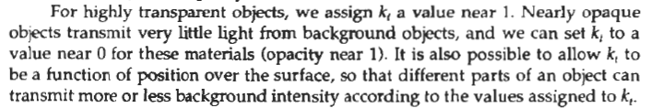
‹#›

Slide 41
Shadows
By applying a hidden-surface method with a light source at the view position, we can determine which surface sections cannot be "seen" from the light source.
These are the shadow areas.
Once we have determined the shadow areas for all light sources, the shadows could be treated as surface patterns and stored in pattern arrays
‹#›

Slide 42
Surfaces that are visible from the view position are shaded according to the lighting
model, which can be combined with texture patterns.
We can display shadow areas with ambient-light intensity only, or we can combine the ambient light with specified surface textures.
‹#›

